Slide 1
Pesticides

Slide 2
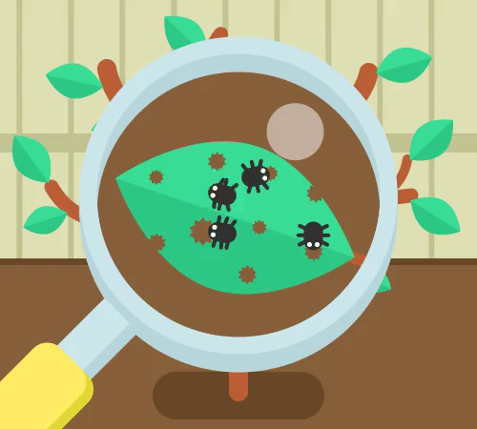
In this Smart Lesson, you will learn about the impacts of pesticides on ecosystems. By the end of the lesson, you should be able to:
• | Explain what an insecticide is.
• | Describe the unintended negative impacts of a pesticide.
• | Explain what biomagnification is.

Slide 3
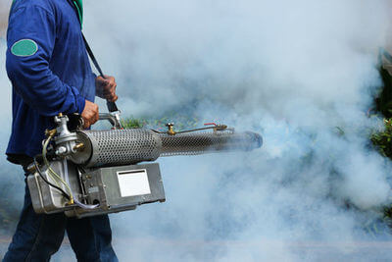
A pest is any organism that attacks or destroys food, crops or livestock.
Farmers actively try to remove pests from their crops or livestock, and prevent them from coming back.
To do this, they use chemicals known as pesticides. These chemicals are designed to disrupt the biochemical processes of particular species.

Slide 4
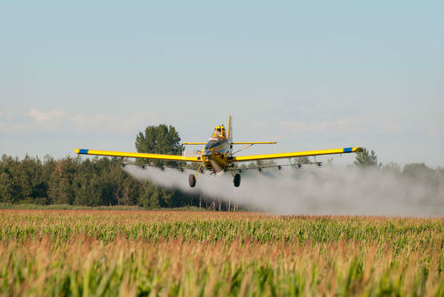
Pesticides can be broken up into smaller sub-groups, depending on what kind of pest they target.
One of these sub-groups is known as insecticides. Insecticides target insect pests and work to block the nerve signals within the body of insects. Blocking nerve signals results in paralysis, and ultimately death.
Insecticides and other types of pesticides are often sprayed over crops by small planes called crop dusters.

Slide 5
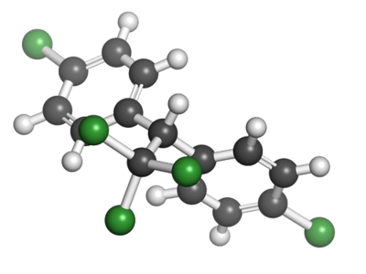
Even though pesticides are used to target specific pests, they can often have further reaching and unpredicted effects on the environment.
One of the best known examples of a pesticide gone wrong in Australia is DDT, short for dichloro diphenyl trichloroethane.

Slide 6
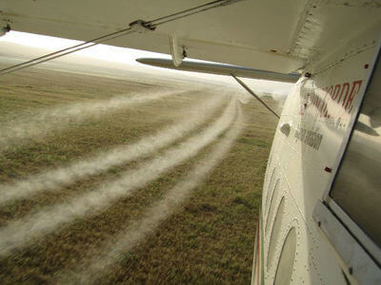
DDT was used throughout the world from the early 1900s, and was banned in Australia in 1987.
DDT was originally developed by Paul Hermann Müller and his colleagues. It was designed to target the insects that carry malaria and other deadly diseases.
By the 1960s, DDT was used for broader agricultural applications.

Slide 7
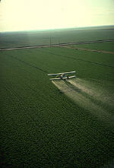
The broader agricultural applications of DDT had some devastating impacts on non-target species, and these impacts were felt throughout all trophic levels.
DDT is toxic, long lasting in the environment, and can be passed on from one trophic level to the next when an organism is consumed. This process of passing a chemical substance on to the next trophic level is known as biomagnification.

Slide 8
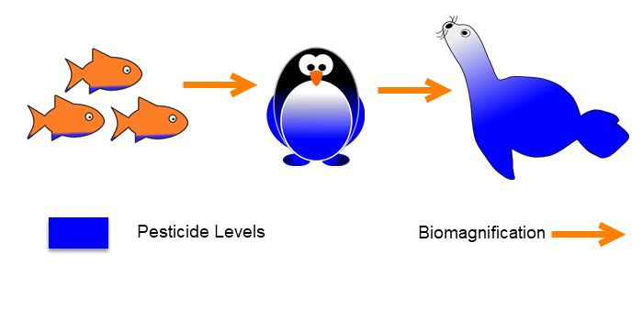
As the trophic level increases, the concentration of a chemical in organisms' tissues increases.
This is because organisms in the lower trophic levels have a low concentration of the chemical, and organisms in higher trophic levels have to eat many of these lower-level organisms to survive. This means animals in higher trophic levels consume a greater concentration of the chemical.
The chemicals tend to build up within organisms over time because they are not able to be excreted.
DDT was able to have such lasting effects within Australian ecosystems due to biomagnification.

Slide 9

Biomagnification means that the concentration of chemicals within the tissues of organisms increases until it reaches a maximum within apex predators.
One apex predator that was heavily impacted by the biomagnification of DDT was the bald eagle (Haliaeetus leucocephalus). High concentrations of DDT disrupted the bald eagle's reproductive cycle, making them produce eggs that were too fragile to survive.

Slide 10
